Slide 1


Identifier Readability &
Program Comprehension
To evaluate and formalize how identifier naming influences code comprehension and propose a practical model to assess readability
Presented by
Bharat B Mane
Registration No: AU/PhD/20/0308
Batch: 2020
Guided by
Dr. Rathnakar Achary Department of Computer Science and Engineering Alliance University
Date: 30 June 2025

Slide 2
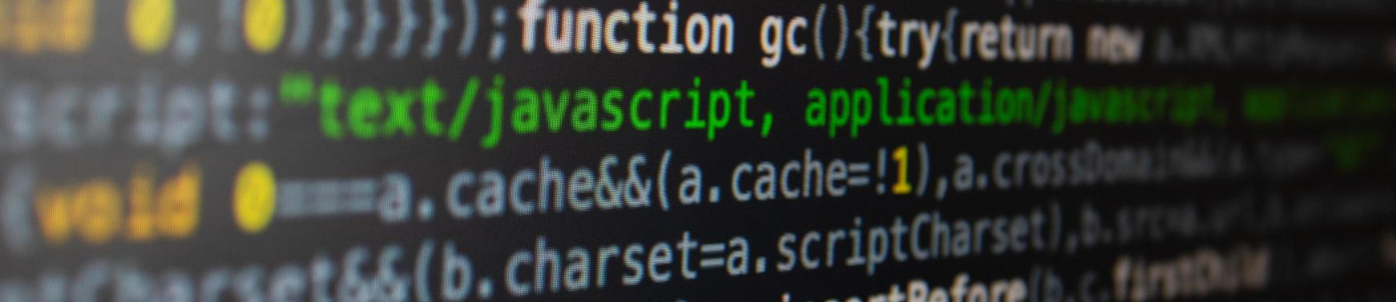
The Human Cost of Unreadable Code
We Read Code Far More Than We Write It —
So Why Don't We Name Things Better?
70%
Time Spent Reading Code
50% Comprehension from Naming
40%
Cost Saved by Readability
91%
Renames to Improve Clarity
“Code is read more often than it is written.” — Robert C. Martin (Clean Code)
Notes:
👀 70% of a developer’s time is spent reading code, not writing it. — (Deissenboeck & Pizka, 2005)
🧩 Over 50% of code comprehension effort is influenced by identifier naming. — (Lawrie et al., 2006; Hofmeister et al., 2017)
🛠️ Readable code reduces maintenance cost by up to 40%. — (Scalabrino et al., 2016)
⚠️ Code with poor identifier naming is significantly more prone to bugs and misunderstanding. — (Butler et al., 2010) 91% of renaming commits are to improve clarity, not just refactor logic. (Arnaoudova et al., 2015)

Slide 3
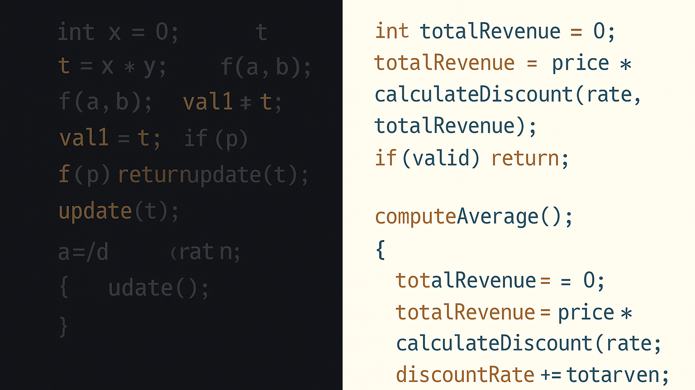

Slide 4
What the Research Says: 20 Years of Evidence
2004-2024
Records Identified
Reviewed 52 peer-reviewed studies
SOURCES
IEEE, ACM, Scopus, SpringerLink, Google Scholar.
Records
Screened
FOCUS AREA
Identifier Readability
Naming Conventions
Code Comprehension
Full-Text Reviewed
METHOD
PRISMA (Systematic Selection & Screening)
Studies
Included (52)
Total Records
Screened
350
120
52
Included
Insight: Consistent, meaningful naming improves comprehension, reduces bugs, and aids maintainability.
Notes:
“To establish a strong foundation, I conducted a systematic literature review from 2004 to 2024 using the PRISMA methodology. We identified 350+ studies initially, screened them rigorously, and included 52 high-quality peer-reviewed works that directly analyzed identifier readability and its impact on program comprehension.”
“Our sources included IEEE, ACM, Scopus, SpringerLink, and domain-specific venues like ICSE and ICPC. We prioritized empirical, cognitive, and tooling studies related to identifier naming.”
“The insight was consistent across two decades — better naming significantly improves how developers read, understand, and maintain software.”

Slide 5
Why Naming Matters: What the Research Shows
Cognitive Perspective
Identifiers act as “cognitive beacons”
Recognizable names trigger mental models (Brooks, 1983)
Clear naming reduces cognitive load
Enables chunking & faster recall (Miller’s 7±2 rule)
Full Words
Abbreviations
Single Letters
Naming Trade-offs & Style
Semantic Clarity > Brevity
Descriptive names aid understanding more than short ones
camelCase vs snake_case
No clear winner — consistency matters more than style
Style | Comprehension Score
x, t, i | ❌ Low
tmp, val, initPt | ⚠️ Medium
totalSales, getInvoiceAmount() | ✅ High
“🧪 Lawrie et al.: Full-word identifiers led to 25–35% faster comprehension”
Notes:
“Across decades of research, a consistent pattern emerges: good identifier naming helps developers understand code faster and with fewer errors.”
“Cognitively, identifiers act like beacons — they anchor meaning and reduce mental effort. Psych studies show that chunking meaningful names frees up working memory.”
“Empirically, experiments show developers perform significantly better with full-word, descriptive names. Even familiar abbreviations help, but short or inconsistent identifiers slow them down.”
“Interestingly, while casing style (camelCase vs snake_case) gets debated a lot, studies show consistency matters far more than style.”

Slide 6
4-Factor Model for Identifier Readability (R(N))
Objective
Formula
Quantify how readable an identifier is
SC: Semantic Clarity
ST: Stylistic Adherence
LN: Length Appropriateness
NL: Natural Language Readability
R(N) = w₁·SC + w₂·ST + w₃·LN + w₄·NL
Weights Calibrated
Based on expert ratings + regression over survey + code dataset
Weights (w₁–w₄) are normalized such that
w₁ + w₂ + w₃ + w₄ = 1.0
Identifier N
Identifier: totalAmountDue R(N) = 0.93 (SC: 1.0, ST: 0.9, LN: 0.9, NL: 0.95)
Semantic
Clarity
Stylistic Adherence
Length Appropriateness
Natural Language Readability
Score SC
Score ST
Score LN
Score NL
Weighted Sum → **R(N) = w₁·SC + w₂·ST + w₃·LN + w₄·NL**
Notes:
To address the lack of objective metrics for identifier quality, I developed a 4-factor readability model. This model assigns a score to any identifier based on how clear, stylistically correct, appropriately sized, and linguistically readable it is.”
“Each factor — semantic clarity, style adherence, length, and natural readability — is individually scored and combined using weights.”
“I calibrated the weights through an expert survey of 10 developers and validated them with a dataset of real-world open-source code, using regression to align with human perception.”
“The result is a scalable, explainable model that aligns well with what developers intuitively feel is a ‘good’ or ‘bad’ name.”

Slide 7
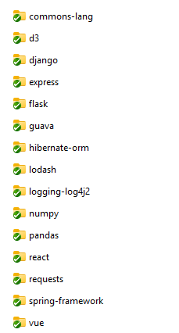
Validating the Readability Model:
Evidence from Real-World Code
Dataset
Validation Results
15 open-source projects
Languages: Java, Python, JavaScript
1 million lines of code analyzed
High-scoring identifiers aligned with expert intuition
Low-scoring identifiers correlated with:
Bug-prone modules
Poor onboarding experience
Negative code review comments
Case Studies
Cleanup of low-score names → measurable improvements in:
Comprehension scores
Onboarding time
Maintenance activity
Identifier Readability Scores – Before and After Cleanup
Identifier | SC | ST | LN | NL | R(N)
x1rdy | 0.1 | 0.2 | 0.5 | 0.1 | 0.23 ❌
retryCount | 1.0 | 1.0 | 0.9 | 0.95 | 0.97 ✅
Notes:
“This slide validates the model in action. We used 15 diverse OSS projects across languages and measured identifier scores over a million lines of code. As expected, good names had high scores and correlated with expert judgment. Low scores flagged identifiers that were bug-prone, slowed onboarding, or attracted reviewer criticism. Here’s an example — you can see how renaming improved readability from 0.23 to 0.97.”

Slide 8

Applying the Readability Model: From Code to Tools
For Developers
For Researchers
Integrate readability scores in code review, PR feedback, and linting tools.
Enables studies on naming, cognition, and LLM-based name generation.
For Toolmakers
Embed model in IDEs or CI workflows to guide naming improvements.
Next Steps
Add context-aware scoring (e.g., based on usage scope and type)
Integrate with refactoring suggestions in IDEs
Evaluate LLM-generated identifiers using the model
Use scores to train ML models for automatic renaming
Notes:
“So what can we do with this model? For developers, we can build linters or review tools that highlight low-readability names. For researchers, this opens new doors in human factors and ML-based identifier suggestions. For tool builders, we can embed this into IDEs or CI pipelines. Next, I’m exploring context-aware adjustments, automated refactoring hints, and even evaluating names suggested by LLMs. This makes naming not just an art — but a measurable, improvable science.”

Slide 9
ANNEXTURE

Slide 11
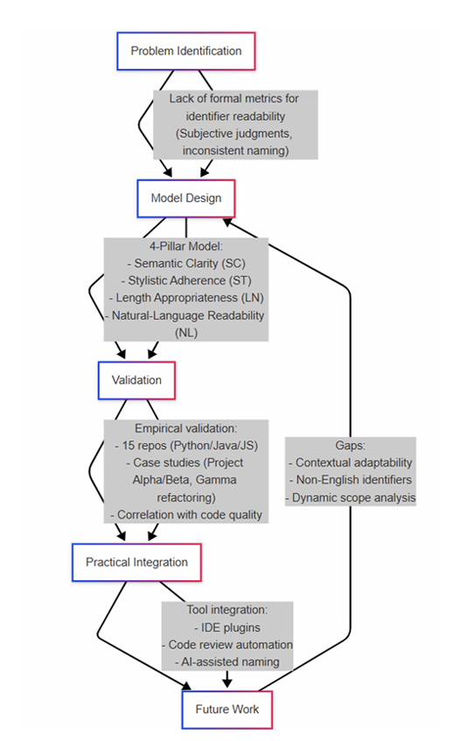

Slide 12
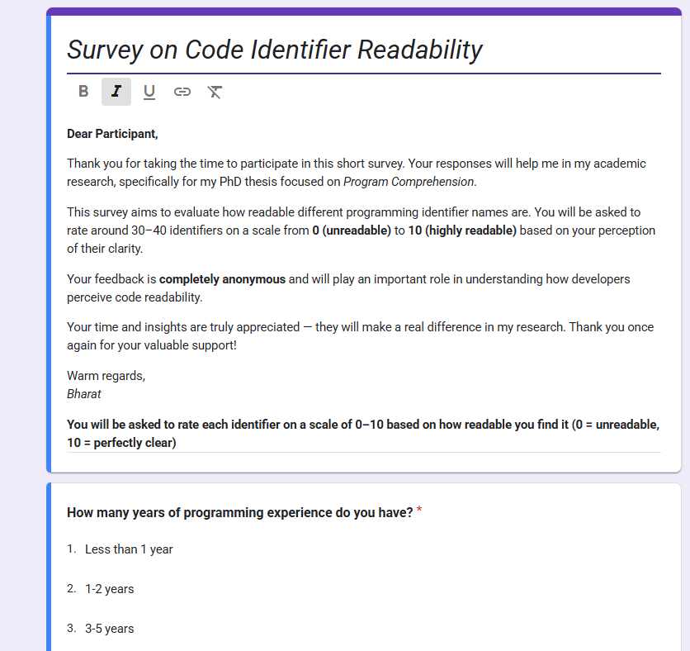
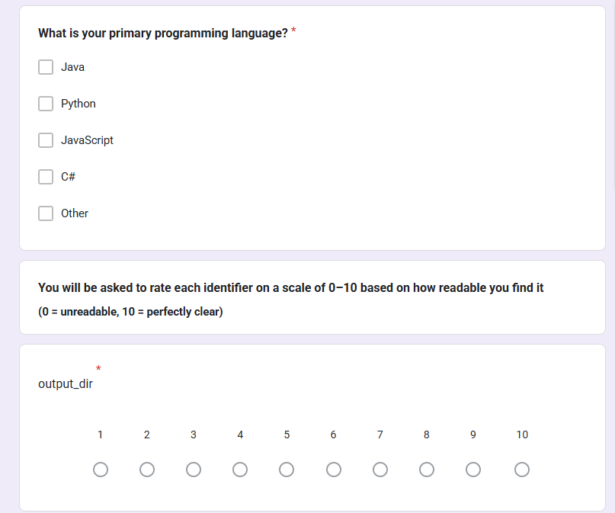
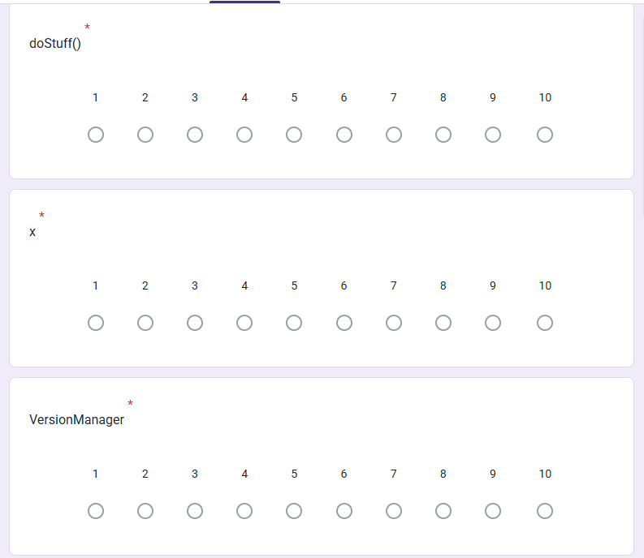
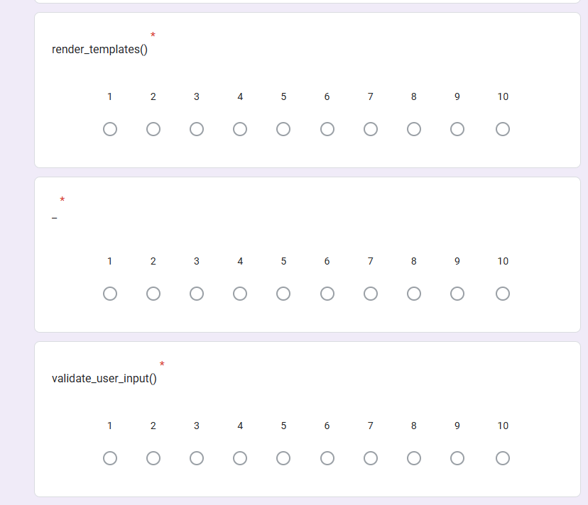
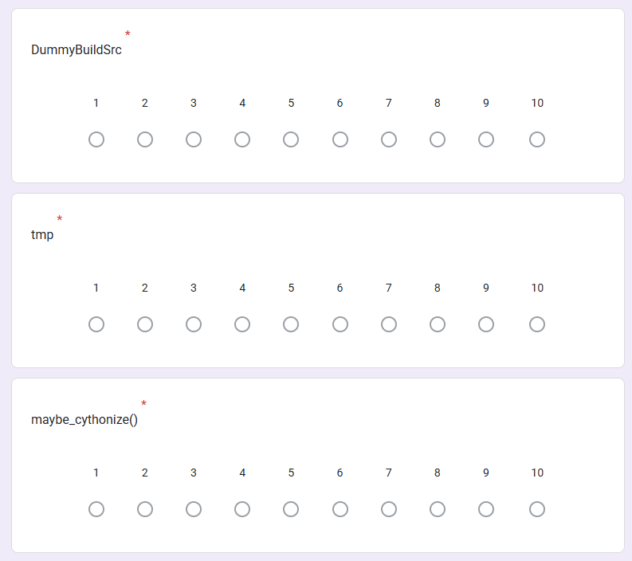
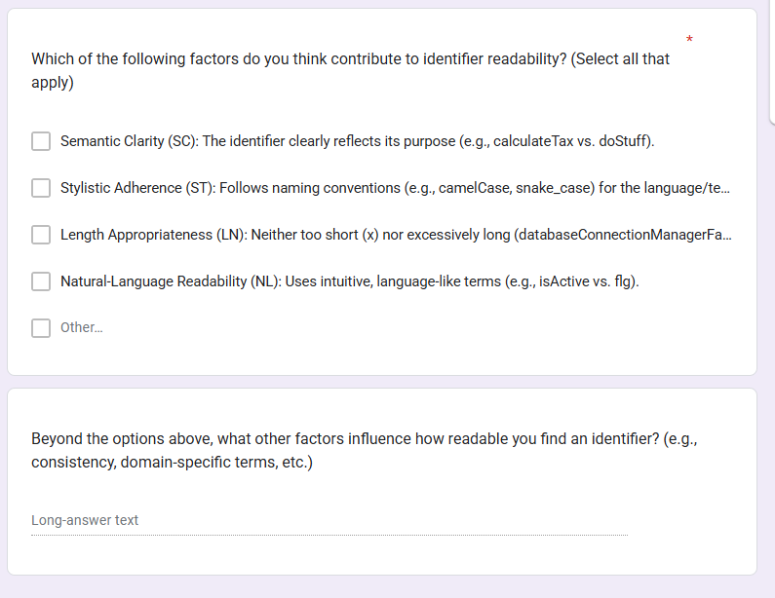

Slide 13
Identifier | Identifier | Identifier | Identifier
output_dir | is_debug_mode | InputValidator | linetrace()
doStuff | Factorize | testIsInitialized() | parsed
x | i, j, k | d | f()
VersionManager | get() | calculate_tax() | user_data
render_templates() | Hashing | LazyInitializerTestImpl | CleanCommand
_ | write_version_info() | clean_me() | initialize()
validate_user_input | process_tempita() | macros | version_info
DummyBuildSrc | ext_data | parse() | db_query()
tmp | run() | MemoizerComputableTest | ConfigParser
maybe_cythonize() | pxifile | setup_cache() | handle()

Slide 15
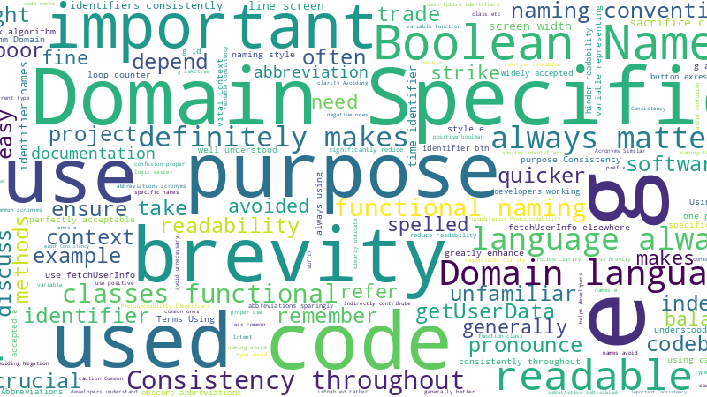

Slide 16
